Slide 1
Professional Front-End Web Development
Introduction

Slide 2
HTML

Slide 3
HTML
HTML Stands for Hyper Text Markup Language.
It is used to specify the content and structure of web pages.
It uses opening and closing tags to build the documents structure
These tags are then recognised by the browser, and will display them in a particular way.
Tags can be given extra data to customise them in different ways.

Slide 4
HTML – With Satan
https://www.youtube.com/watch?v=27dnddCq5gc

Slide 5
HTML5

Slide 6
HTML5
HTML5 is a collection of technologies.
Browser support can be inconsistent, especially on slightly older browsers.

Slide 7
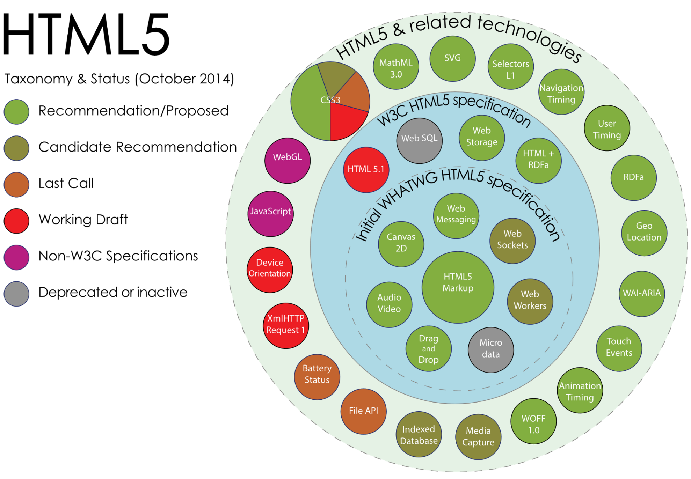
HTML5 Taxonomy & Status
We don’t need to know all of these to get started with HTML5 however it is useful to understand how HTML5 is structured.
By Mercury999 - Own work, CC BY-SA 4.0, https://commons.wikimedia.org/w/index.php?curid=36352535

Slide 8
DOM

Slide 9
Document Object Model
The DOM (Document Object Model) is a convention for representing and interacting with objects in a mark-up language.
This convention is cross-platform and language-independent.
The DOM utilises a tree structure to provide a logical and easily representable layout.
We can traverse this structure within code, travelling to nodes (objects) through the hierarchical layout.
The DOM in HTML is defined by the order of tags within the document.

Slide 10
Document Object Model
<!DOCTYPE html>
<html>
<head></head>
<body>
<div id="header">
<h1>Welcome to WebExample.com!</h1>
</div>
<div id="content">
<h2>Homepage</h2>
<p>There is nothing on this website.</p>
</div>
<div id="footer">
<p>Contact admin@webexample.com.</p>
</div>
</body>
</html>
Document
<html>
<head>
<body>
<div id=“header>
<div id=“content”>
<div id=“footer”>
<h1>
<p>
<h2>
<p>
Notes:
https://www.w3schools.com/html/tryit.asp?filename=tryhtml_basic

Slide 11
Creating a new HTML file
Our file is split into 2 sections: head & body.
The head contains all the metadata for our page.
The body contains all the content.
Save as name.html
<html> <head> <title>QA</title> </head> <body> Hello World
</body> </html>
Notes:
“What is metadata?”
Data about data

Slide 12
Structuring Content
<body> <div id="header">
<h1>Welcome to WebExample.com!</h1>
</div>
<div id="content">
<h2>Homepage</h2>
<p>There is nothing on this website.</p>
</div>
<div id="footer">
<p>Contact admin@webexample.com .</p> </div> </body>
Within the body we can use <div> tags to divide content.
We can use <nav> tags indicate that the contained content is a navigation element.
We can also use <section> tags to indicate page sections.
If we end a tag with /> then it removes the trailing tag (</tag>).

Slide 13
Attributes
We have already seen examples of HTML attributes in a few of our elements.
An attribute provides additional information about an HTML element.
The attributes available are different between each element, and the browser knows how to interpret each of them.
We always specify an attribute within the opening tag.
Attributes are defined by name/value pairs. ie. src=“logo.jpg”
<div id=“exampleID”></div>

Slide 14
When to use Each Structure Tag
If it’s a Major Navigation Block:
<nav>
If it Makes Sense on its Own:
<article>
If it isn’t Needed to Understand the Content:
<aside>
If its Logical to add a Heading:
<section>
If there's any Other Semantic Meaning:
<header>
<footer>
If you Reach This:
<div>

Slide 15
Adding images
<nav> <!-- Main Navigation --> <div> <div> <!-- Page Branding --> <a href="manage_stock.html"> <img alt="NB gardens" src="img/QA_logo_blue.png" width="50px" height="50px"/> </a> </div> <div id="navbar">
…
</nav>
Links to other pages are added using the <a> tag with href used to specify the destination.
Images are added with <img> with src used to specify the file.
alt is used to specify alternative text.
Why should we use alt?
Notes:
We can add comments using <!-- comments -->

Slide 16
Unordered and Ordered Lists
Here we are specifying a bullet point list using the <ul> tag.
If we wanted a numbered list we could use the <ol> tag instead.
Each point in the list is specified with the <li> tag.
<div id="navbar"> <div> <!-- Page Links --> <ul> <li><a href="manage_stock.html"> Manage Stock </a></li> <li><a href="replenish_stock.html"> Replenish Stock </a></li> </ul>
Notes:
Href stands for hyper text reference

Slide 17
Forms
Whenever we want to get an input from the user in a web page we can use a form to link the elements together
Forms are used to wrap inputs.
Inputs have a type which is used to bring up contextual controls on mobile.
Placeholders should be used with alts because if a user with a screen reader focuses on the input the placeholder disappears.
<form> <div> <input type="email" placeholder="email..." alt="Enter Email" required="required" /> <input type="password" placeholder="password..." alt="Enter Password" required="required" /> <button type="submit">Sign In </button> </div> </form
Notes:
Common ones are input type=“text” and “number”

Slide 18
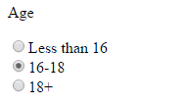
Radio Buttons in forms
When using radio buttons in a form we need to group them using the name attribute.
The name attribute allows us to group the buttons together.
Users can only select one button in each name group.
<form> <p>Age</p> <input name="age" type="radio"/>Under 16 <br/><input name="age" type="radio"/>16-18 <br/><input name="age" type="radio"/>18+ </form>

Slide 19
Sections, Headers, Footers & Bookmarks
The <section>, <header> and <footer> tags behave in the same way as a div.
They are used to provide semantic meaning.
We can use the <a> tag to move us around pages as well as between them.
We do this by setting the href to the id of another tag prefaced with ‘#’;
<div class="mainContent"> <section id="stockListSection"> <header> <h2>Product List</h2> </header> <!-- stock list --> <footer> <a href="#stockListSection"> top </a> </footer> </section>

Slide 20
Tables
If we want to make a table we can use the <table> tag.
To add rows within the table we use the <tr> tag.
<th> is used to specify a table header cell while <td> is used to specify a normal cell.
<tbody> can be used to separate the rows that make the body of the table.
http://daviddickball.uk/2011/04/why-you-shouldnt-use-tables-for-layout-ever/
<!-- stock list --> <table> <tr> <th>Product</th> <th>Quantity</th> <th>Status</th> </tr> <tbody> <tr> <td>Just Boots</td> <td>10</td> <td>ACTIVE</td> </tr> </tbody> </table>

Slide 21
Displaying text
We can use <h1> - <h6> tags to render text as headings.
The <p> tag is used to wrap a paragraph of text.
The <q> tag is used to wrap quotes.
There are many other tags that we can add to text to provide semantic meaning.
<section> <header> <h2>Manage Product</h2> </header> <div> <h3>Just Boots</h3> <p><q>Boots and stuff</q> Integer dolor sem,…</p> </div>

Slide 22
<a> targets
_blank - Opens in a new window or tab.
_self - Opens in the same window/tab as it was clicked (this is default).
_parent - Opens in the parent frame.
_top - Opens in the full body of the window.
framename - Opens in a named frame.
</div> <footer> <button>Edit</button> <button>Discontinue</button> <a href="…" target="_blank"> View on Store front </a> </footer> </section> </div> </div> </body> </html>

Slide 23
CSS/CSS3

Slide 24
Objectives
To discuss what CSS is.
Gain Practical knowledge in CSS.

Slide 25
What is CSS?
CSS stands for Cascading Style Sheets.
CSS is used to change the look and feel of our HTML content.
Think of HTML as a chair and CSS as the fabric you use to cover the chair.

Slide 26
Linking CSS to HTML
CSS files can be referenced by our HTML files by using the <link> tag.
By convention our CSS files belong in a dedicated folder.
This keeps our directories clean and makes it easier to find files.
projectname/css/style.css
<link href="css/style.css" rel="stylesheet" type="text/css" />

Slide 27
Example HTML code
<!DOCTYPE html><html> <head> <meta charset="ISO-8859-1"> <title>welcome</title> <link href="css/style.css" rel="stylesheet" type="text/css" /> </head><body> <div class="mainContent"> <div class="navigation"> <ol> <li><a id="home" href="www.qa.com"> Home</a></li> <li><a href="www.qa.com/about-qa"> About</a></li> <li><a href="https://www.qa.com/online-courses">Products</a></li> <li><a href="info@qa.com"> Contact</a></li> </ol>
</div> <div class="content"> <p>Vestibulum et ipsum non turpis ultricies pretium at ut enim. Fusce et arcu sit amet lorem consequat scelerisque. Ut vulputate metus ac ante interdum, ut scelerisque lectus scelerisque. Fusce placerat nibh eros, vel auctor nisl facilisis at. Suspendisse id rhoncus dolor. Vivamus ac velit ultricies, dignissim urna vel, posuere arcu. Nulla quis massa imperdiet, efficitur mauris in, gravida ante. In molestie tempor euismod. Maecenas at porta magna. Proin sed pretium lectus, at pretium leo. In tellus arcu, efficitur a nulla et, consectetur malesuada urna. Curabitur facilisis diam enim, non pharetra nibh tincidunt in. Vestibulum ipsum enim, rhoncus vitae luctus vitae, tempus eu sapien.</p> </div> </div> </body></html>

Slide 28
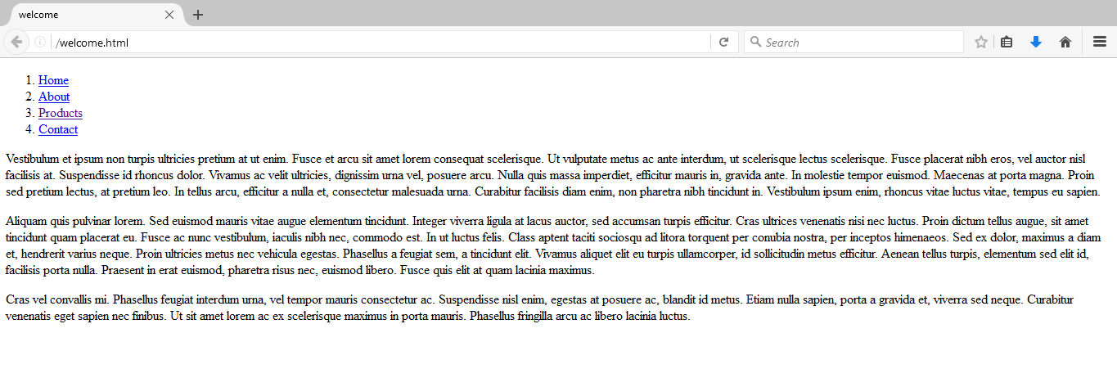
Example Code Without any CSS

Slide 29
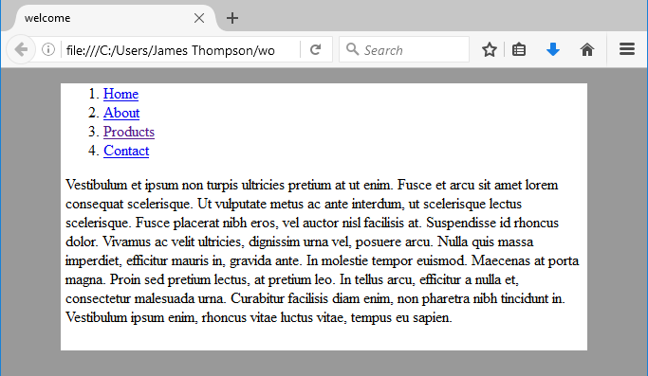
Adding some basic CSS
Within Style.css we define our CSS rules in key/value pairs.
For now we will apply styles to the <html> and <body> tags
@CHARSET "ISO-8859-1";
html { background-color: #999999; }
body { background-color: #FFFFFF; width: 80%; margin-left: auto; margin-right: auto; }

Slide 30
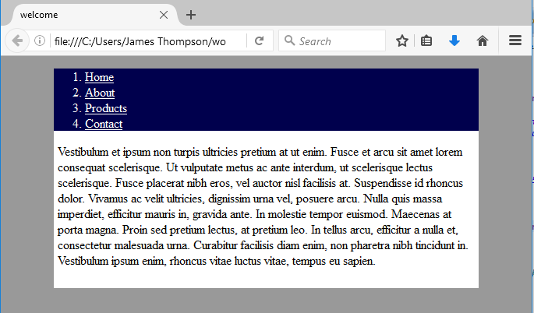
CSS Class Selectors
We can apply styled to groups of tags by assigning them classes using the ‘.’ selector.
.mainContent { padding: 0px 5px 10px 5px; }
.navigation { background-color: #00004d; color: #FFFFFF; }
.navigation a:link { color: #ffffff; }
.navigation a:visited { color: #ffff00; }

Slide 31
CSS id Selector
To style individual HTML elements they need an id which can be access using the ‘#’ selector.
When applying styles to classes we can specify tags within that class by adding the tag to the selection separated with a space.
Elements such as <a> tags also have events which we can apply styles to.
#home { font-weight: bold; }
.navigation { background-color: #00004d; color: #FFFFFF; padding: 0px 0px 0px 0px; width: 100%; display: table; }
.navigation ol { padding: 0px 0px 0px 0px; margin: 0px 0px 0px 0px;
}
.navigation a:visited { color: #ffffff; }

Slide 32
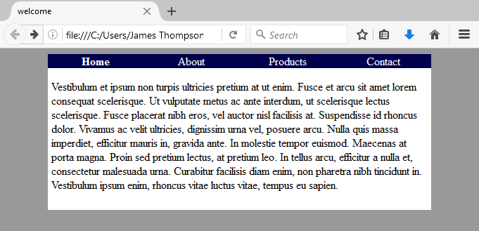
Finishing off the CSS
.navigation li { display: table-cell; text-align: center; vertical-align: middle; float: left; width: 25%; }
.navigation li:hover { background-color: #3333ff; }
.navigation a:link { color: #ffffff; text-decoration: none; }

Slide 33
Before
Notes:
https://www.w3schools.com/html/tryit.asp?filename=tryhtml_basic

Slide 34
After

Slide 35
CSS
Bootstrap

Slide 36
What is Bootstrap?
Bootstrap is a very popular and widely used responsive framework.
When we call something responsive what we mean is that the page will adapt based on the device used to view that page.
Bootstrap is a collection of CSS and JavaScript which we link into our HTML and leverage with classes and id’s.
If HTML is the chair, CSS is the material we are using to cover the chair then JavaScript turns that chair into a rotating chair.
Bootstrap is like buying a chair that’s been covered and made into a folding chair for us already.

Slide 37
Linking Bootstrap CSS into our HTML
We link the bootstrap CSS in the same way we link our own CSS.
We can link multiple CSS files into a single HTML file.
We want our CSS to be the last stylesheet linked so that we can override bootstraps CSS not the other way around.
We also need the viewport to improve rendering and touch zooming.
<head> <meta name="viewport" content="width=device-width, initial-scale=1"> <link href="css/bootstrap.min.css" rel="stylesheet" media="screen"> <link href="css/main.css" rel="stylesheet" media="screen"> </head>

Slide 38
Linking Bootstrap JavaScript
For bootstrap to work properly we need to link in the javascript for both bootstrap and Jquery.
JQuery is a JavaScript library that focuses on adding animation and transitions to websites.
You can also see here how you can link JavaScript using both URL’s and JavaScript files packaged with the HTML.
<body></body> <script src="https://ajax.googleapis. com/ajax/libs/jquery/1.12.4/jquery.min.js"></script> <script src="js/bootstrap.min.js" type="text/javascript"></script> </html>

Slide 39
Making a Bootstrap navbar
We will be using the same code from the HTML example.
Here we are applying rules to our nav and div tags to move them to the top of the screen.
Each class will apply a couple of rules to manipulate the pages Structure.
navbar-fixed-top for example only sets the element to move with the user when scrolling
<nav class="navbar navbar-fixed-top navbar-inverse"> <div class="container"> <div class="navbar-header">

Slide 40
Burger Button
When the screen gets too small to display our navigation links we want them to collapse into an expandable menu.
We can use this bit of code to render that button when this happens.
The data-target is used by JavaScript to take any element within the specified id into the dropdown.
</a> <button data-toggle="collapse" class="navbar-toggle collapsed" data-target="#navbar" type="button" aria-expanded="false" aria-controls="navbar"> <span class="sr-only"> Toggle Navigation </span> <span class="icon-bar"></span> <span class="icon-bar"></span> <span class="icon-bar"></span> </button>

Slide 41
Making our Menu Collapsible
We want our menu links to be included in the dropdown so we will give the containing <div> the id of navbar.
We will also use the class of navbar-right to float the elements to the right of the navbar.
All of the classes we are applying we can override in our own CSS files.
<div id="navbar" class="collapse navbar-collapse"> <div class="navbar-right"> <!-- Page Links --> <ul class="nav navbar-nav"> <li class="navbar-brand"> <a href="manage_stock.html"> Manage Stock</a></li> <li class="navbar-brand"> <a href="replenish_stock.html"> Replenish Stock</a></li> </ul>

Slide 42
Navbar Form
We will be applying styles to our navbar form as well.
The btn class will style the button to look more buttony.
btn-success will make the button visually distinctive to other buttons.
</ul> <form class="navbar-form navbar-right"> <button class="btn btn-success"> Exit </button> </form> </div>

Slide 43
Bootstrap Columns
Here we are specifying how many columns we want each section to take up.
We can change the number of columns based on the size of screen.
The sizes are lg, md, sm and xs.
We must have a div with the class of container wrapping any column classes
<div class="mainContent"> <!-- Main Content --> <section id="stockListSection" class="col-md-3 col-sm-4"> <!-- stock list --> </section> <section class="col-md-9 col-sm-8"> <!-- Product detail view --> </section>

Slide 44
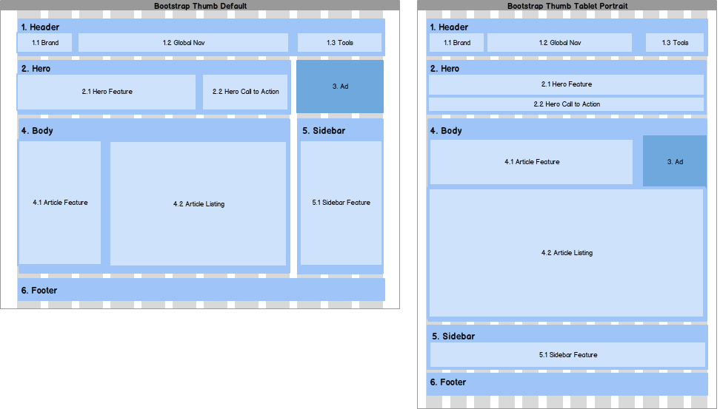
Bootstrap Grids
Here we can see an example of bootstraps grid system.
As the screen narrows the elements on the page rearrange.
This allows for a better mobile experience.

Slide 45
Example bootstrap
https://blackrockdigital.github.io/startbootstrap-freelancer/
https://startbootstrap.com/

Slide 46
Government Template
https://www.gov.uk/service-manual/design/using-the-govuk-template-frontend-toolkit-and-elements
Government templates have to conform to very particular standards
Use specific Font colours, sizes, positioning of elements

Slide 47
Coding Challenge
Create 3 HTML pages
Edit it so that it suits the following criteria;
Pages:
Home
Project List
About me
The pages should not contain information provided initially in the template
Edit them to be more appropriate for you.
Home page should have an introduction to you and your site as well as navigation to your other pages
About me page should have the following content;
An introduction to who you are
Past achievements, future goals etc.
Basically an online copy of your CV
Project List page should be formatted in a way where you can have multiple posts on the page for your projects
Notes:
Feel free to use bootstrap!

